Slide 1
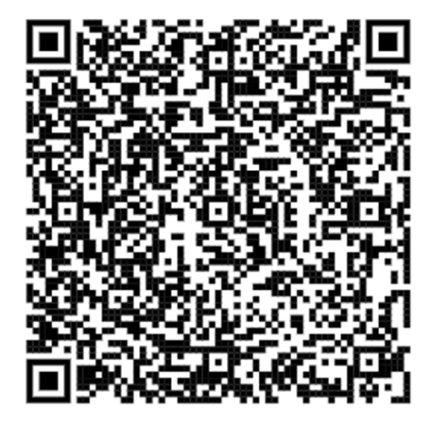
Thank you for your feedback!
Generative AI for Engineers (for PUB)
Under the Course ID & Class ID, please key in “NA”
Today’s date is 22 Sep 2026

